Slide 1
Unit 7 Reading Scientific Literature
——
山东大学

Slide 2
Getting Familiar with Scientific Literature
Suggested Reading skills and strategies
Reading Practice

Slide 3
Part one Getting Familiar with Scientific Literature
Warm-up
Can you classify the following forms of literature into primary, secondary, and tertiary sources?
standards, monographs, technical reports, science magazines, review articles, encyclopedias, graduation papers, handbooks, textbooks, conference proceedings, patents, journals,

Slide 4
Part one Getting Familiar with Scientific Literature
Primary literature | Secondary literature | Tertiary literature
technical reports
graduation papers
conference proceedings
patents
journals
monographs
review articles
standards
science magazines
encyclopedias
textbooks
handbooks
summarized for scientists with some understanding of the topic
edited usually for lay audience
Note: In many cases, secondary and tertiary literature is referred to generally as secondary literature in contrast with primary literature.

Slide 5
Part one Getting Familiar with Scientific Literature
2. Scientific research steps
Location
Stage
finding out what’s known & unknown about a topic,
refining hypotheses
Library
(library research ）
Preliminary research
Lab or Field
(Experimental research)
designing experiments, testing hypotheses
Original research
The growth of scientific knowledge depends crucially on the research steps.

Slide 6
Part one Getting Familiar with Scientific Literature
3. The cycle of scientific literature
recording the first results
primary literature
original research
preparing for a new topic, a new research project
summarized and synthesized
compiled
reference sources
secondary literature
(overviews of scientific topics, data, facts, definitions)
Notes:
Reference sources often relate to the core understandings of a topic. Information has often been reviewed and tested many times before inclusion. Focused, raw data is often not included, but background and analysis may be given in great detail.

Slide 7
Part two Reading SL
Unlike reading an article about science in a blog or newspaper, reading a scientific paper is a completely different process. Not only do you need the sections in a different order than they are presented, but you also have to take notes, read it multiple times, and probably go look up other papers for some of the details. Reading a single paper may take you a very long time, at first. Be patient with yourself. The process will go much faster as you gain experience.

Slide 8

How do expert readers approach a scientific paper?

Slide 9
1. Expert readers of scientific literature often read with a very specific purpose. They may not read the entire paper. Instead, they focus on sections of the paper that will answer their exact questions. When initially analyzing a paper, you may not have a specific question in mind, but you should try to develop questions as you continue to read.

Slide 10
2. Experts readers of scientific literature approach a paper with a critical mindset. This means that they do not automatically accept an author's conclusions. Rather, experience readers examine whether an experiment and its data and analysis support the claims of the author. Readers are persuaded by the data and its analysis, not by an author's writing.

Slide 11
3. To read scientific papers effectively, it is important to understand the individual sections of a scientific paper. All scientific papers have the same general format. They are divided into distinct sections and each section contains a specific type of information. The number and the headings of sections may vary among journals, but for the most part a basic structure is maintained.

Slide 12
knowing your specific purpose
being critical and active
knowing the basic structure of scientific paper

Slide 13
Part two Suggested reading skills and strategies
1. Know your purpose，and adapt your style accordingly.
Purpose | Style
To locate specific information
scanning
To inform yourself generally
reading steadily without noting
To gather material for a task
reading carefully, making notes
reading the methods, jotting down diagrams before reading the results
To understand an experiment

Slide 14
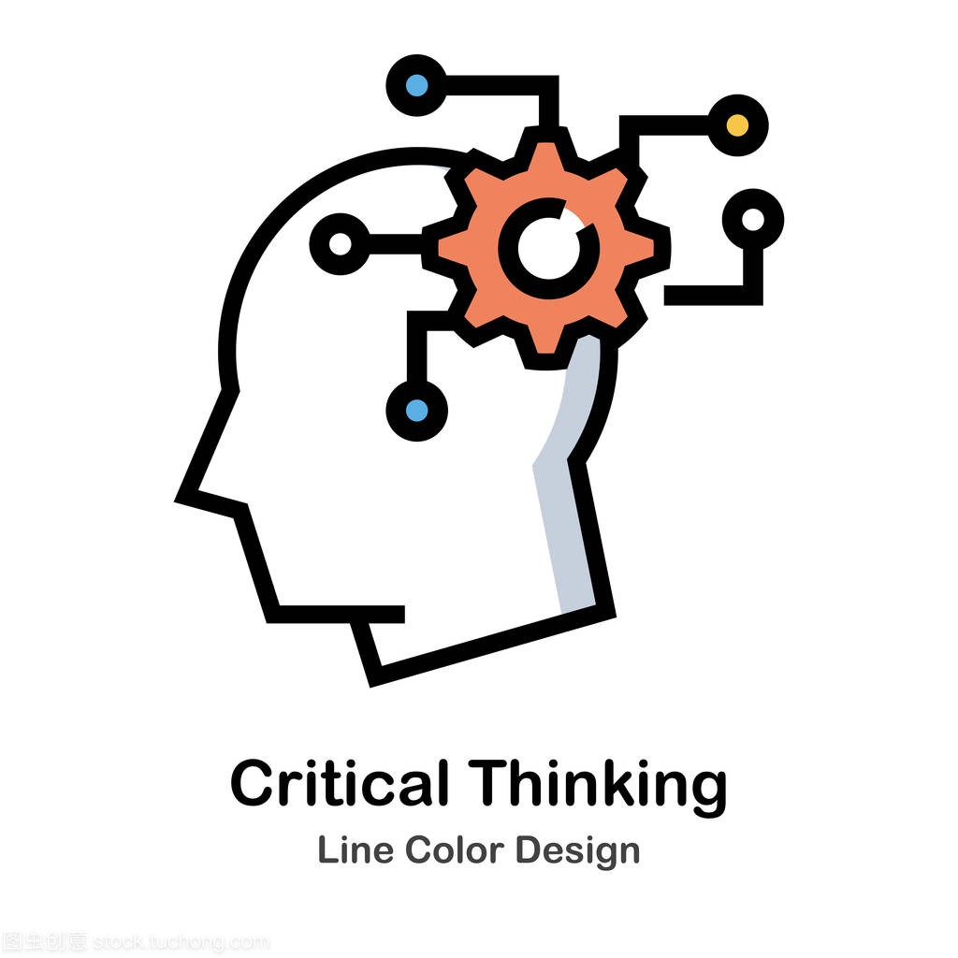

2. being critical and active
A Question for Consideration
One of the assumptions many students make is that the writer, being an expert in his/her field, must always be correct. This is by no means always the case. As a reader, you must learn to appraise objectively the work of others, i.e. using critical thinking skills.
How can you read a scientific article critically?

Slide 15
Reading Critically and Actively
Reading critically and actively is closely connected to an ability to analyse and evaluate the material you read.
Active reading involves engaging with a text in order to understand what it contains. This could mean highlighting key words and phrases, making annotations in the margin, testing yourself as you read, discussing with or explaining it to someone else after reading,
Critical reading involves asking questions about the text.

Slide 16
Some questions for framing your reading
What is the issue/main argument?
Where has this text came from (What is the source--- is it a journal article, a scientific work, a newspaper clipping (剪报）, and extract from a blog?)
Is it an authoritative source? (Do I trust it? Why?)
What is the author’s main point, argument or thesis? ( What’s at stake?)
What evidence is used to support this?
How valid is that evidence? What is it based on ---- statistics, research data, the views of other scholars, personal opinion? Do I trust it? Why, why not?

Slide 17
Some questions for framing your reading
Why is the writer presenting this point of view?
How is the argument presented?
Is the writer using emotional or persuasive language?
Do other writers agree with these ideas?
Do I agree with these ideas? (Why or why not?)
( Adapted from the ACU Academic Skills Uni resources )

Slide 18
Some suggestions to help you to read critically and actively
1) Keep good notes and organize the notes for easy future referencing.
(One effective way of making notes is to draw a mind map.)
2) Read the paper twice. Initially, read it quickly to get a general understanding of the question, methods, results, and significance. Your second reading should be more critical and skeptical.
3) Pay attention to the data, tables, and graphs (Graphs, tables, data and charts can summarize key information in a very economical way). The data are the backbone of the paper and you need to understand them. Compare your impression of them with the author’s interpretation.

Slide 19
4) Make comments. Highlight or underline the parts that you think are important. Write notes in the margin. Use a question mark to note things that you don’t understand.
5) Read critically. What assumptions do the authors make? Are they valid? Can the methods really answer the questions posed? Are the arguments logical? Are alternatives considered?
6) Don’t get bogged down（放慢速度；陷入停顿；遇到问题）. A scientific paper should tell a story and the plot is more important than the details. Skip difficult parts to avoid losing the story line. Come back to them later to see if you can reason them out.

Slide 20
In Sum
What do critical readers do?
They approach a text with curiosity ---- they ask questions as they read.
They do not accept at face value the idea under discussion ---- either its accuracy or that it’s the only way to think about the topic.
They identify the positive (useful) components of an argument & the negative (weak, flawed) sections.
They analyse & identify the evidence base provided for an argument in order to understand the author’s rationale & position.

Slide 21
What do critical readers do? (Cont.)
They identify component parts of an argument ---- content (basic facts), themes (overall ideas or claims), “evidence”( supporting materials) and they use this to raise issues about a text’s application, potential, usability.
They think about the relationship between the text and other texts and authors. They see the text as part of a conversation.
They form opinions about what they read --- and they back it up through a compilation of the above.
Adapted from: http://www.uq.edu.au/student-services/Reading+critically

Slide 22
Structure of scientific papers
The structure of scientific papers is very different from that of other forms of writing, and the content of scientific papers can be complex. In our first step towards becoming expert readers of the scientific literature, we will explore two questions:
How do experts readers approach a scientific paper?
What is the structure of the scientific paper?

Slide 23

title
abstract
introduction
methods
results
discussion
reference
(Each will be explained in detail in next chapter)

Slide 24
III. Five Steps for Reading a Scientific Paper
Step 1. Skim the article and identify its structure
Step 2 Distinguish main points
Step 3. Generate questions and be aware of your understanding
Step 4. Draw inferences
Step 5. Take notes as you read

Slide 25
Step 1. Skim the article and identify its structure
Most journals use a conventional IMRD structure. An abstract followed by Introduction, Methods, Results, and Discussion. Each of these sections normally contains easily recognized conventional features, and if you read with an anticipation of these features, you will read an article more quickly and comprehend more.
International Master of Science in Rural Development

Slide 26
Features of Abstracts
Abstracts usually contains four kinds of information:
purpose or rationale [ˌræʃəˈnɑːl] （基本原理，基础理论; 根据）of
study (why they did it)
methodology (how they did it)
results (what they found)
conclusion (what it means)

Slide 27
Abstract 1:
This paper aims to reveal more of the hidden secrets of the Cheops Pyramid in terms of the descending rays of the sun during the equinox falling upon the azimuth of the diagonal secant position at the solar successions. The methodology used to complete this investigation project is based on the collection and analysis of data related to the erection principles practiced when the pyramid was constructed during the era of the Fourth Dynasty Egyptian Pharaoh Khufu. These principles are the key for the geometrical representations of the balanced states across the residual depictions of the sun's position relative to the Cheops Pyramid during the equinox. This research has found that the apex is an inevitable predetermined inclusion within the theorem of universal expansion. Moreover, the inclinations of the pyramid were set to predetermine the location of its plumb line, thereby serving as a guiding factor in erecting the blocks of the Cheops Pyramid. The main conclusion is that there is a strong relationship between the Cheops Pyramid geometry, the erection of its steps, and the solar equinox.

Slide 28
Part three Reading Practice
KEY: Look for key words or phrases
What is the aim of the study?
(beginning; “aim to”, “explore”, “investigate”, “to …” )
What is the method used?
(first half; “in this method”, “by …” “methodology”, “be applied to”)
What are the results?
(later half; “data show”, “results”, “findings”)
What is the conclusion of the results?
(end)

Slide 29
Abstract 2:
Informed by literature on developing pedagogical content knowledge (PCK) through teacher collaboration, this study aims to investigate the trajectory of PCK development among business English teachers through module team collaboration in Chinese context. Drawing upon multiple sources of data including observation, semi-structured interview, and teaching materials from three case teachers, this study explores how PCK components were developed in one academic year when case teachers participated in module team collaborative activities. The findings show the individual differences among the three participants in their PCK development and reveal that two key PCK components -- Knowledge of stadents' understanding and Knowledge of instructional strategies have developed through teacher collaboration. This study suggests the collective inquiry in teacher collaboration.

Slide 30
2. Features of Introductions
Two purposes:
arousing readers' interest in the subject
providing them with enough information to understand the article.
Three elements:
broad information (what is known about the topic) → more specific information (what is not known) → a focal point (what questions the authors asked and answered).
（Authors describe previous work that led to current understanding of the topic (the broad) and then situate their work (the specific) within the field.）

Slide 31
3. Features of Methods
The Methods section tells the reader what experiments were done to answer the questions stated in the Introduction.

Slide 32
4. Features of Results and Discussion
The Results section contains what was found, and reference to the data shown in visuals（图形部分）.
The Discussion functions to
1）place the work in context of the broader field. (compare with others’ result…)
2）provide a clear answer to the question posed in the Introduction
3）explain how the results support that conclusion.

Slide 33
Therefore, when you begin to read an article for the first time, skim the article to analyze the document as a whole.
Are the section labeled with headings that identify the structure? If not, note what the structure is.
Decide which sections contain the material most essential to your understanding of the article.
Then decide the order in which you will read the sections.

Slide 34

Step 2 Distinguish main points
Because articles contain so much information, it may be difficult to distinguish the main points of an article from the subordinate points. Fortunately, there are many indicators of the author's main points:

Slide 35
Document level
title
abstract
keywords
visuals (especially figure and table titles)
first sentence or the last 1-2 sentences of the Introduction

Slide 36
Paragraph level: words or phrases to look for
surprising
unexpected
in contrast with previous work
has seldom been addressed
we hypothesize that…
we propose…
we introduce…
we develop…
the data suggest…

Slide 37
Step 3. Generate questions and be aware of your understanding
Reading is an active task. Before and during your reading, ask yourself these questions:
Who are these authors? What journal is this? Might I question the credibility of the work?
Have I taken the time to understand all the terminology?
Have I gone back to read an article or review that would help me understand this work better?
Am I spending too much time reading the less important parts of this articles?
Is there someone I can talk to about the confusing parts of this article?

Slide 38
After reading, ask yourself these questions:
What specific problem does this research address? Why is it important?
Is the method used a good one? The best one?
What are the specific findings? Am I able to summarize them in one or two sentences?
Are the findings supported by persuasive evidence?

Slide 39
Is there an alternative interpretation of the data that the author did not address?
How are the findings unique/new/unusual or supportive of other work in the field?
How do these results relate to the work I’m interested in? To other work I’ve read about?
What are some of the specific applications of the ideas presented here? What are some further experiments that would answer the remaining questions?

Slide 40
Step 4. Draw inferences (举一反三，推断)
Not everything that you learn from an article is stated explicitly. As you read, rely on your prior knowledge and world experience, as well as the background provided in the article, to draw inferences from the material. Research has shown that readers who actively draw inferences are better able to understand and recall information.
As an example, in the box below is an excerpt from the Introduction of an article in the journal Biochemistry (Ballestar et al., 2000). The comments in italics are questions and influences that might be drawn by a student reader.

Slide 41
Rett Syndrome (雷特综合症) is a childhood neurodevelopmental disorder and one of the most common causes of mental retardation （智力迟钝） in females. Rett Syndrome patients are characterized by a period of normal growth and development (6-18 months) followed by regression （退化）with loss of speech and purposeful hand use. Patients also develop seizures（癫痫）, autism（自闭 ）and ataxia（失调）. After initial regression, the condition stabilizes and patients survive into adulthood. Studies of familial cases provided evidence that Rett is caused by X- linked dominant mutations（突变） in a gene subject to X- chromosome inactivation（失活，灭活）. Recently, a number of mutations in the gene encoding the methyl-CpG （甲基化-CPG）binding transcriptional（转录的） repressor（阻抑物） MeCP2 have been associated with Rett Syndrome.

Slide 42
Rett Syndrome is a childhood neurodevelopmental disorder and one of the most common causes of mental retardation in females.
Comment: Hmmm… must be related to a gene on the X-chromosome, with an incident of 1 in 10,000—15,000.
Comment: How common is that? Not too likely to happen to me, but there must be several such children born in Houston every year.
Rett Syndrome patients are characterized by a period of normal growth and development (6-18 months) followed by regression with loss of speech and purposeful hand use.
Comment: What happens? Something must be triggered or activated at late infancy.

Slide 43
Patients also develop seizures, autism and ataxia. After initial regression, the condition stabilizes and patients survive into adulthood. Studies of familial cases provided evidence that Rett is caused by X- linked dominant mutations in a gene subject to X- chromosome inactivation. Recently, a number of mutations in the gene encoding the methyl-CpG binding transcriptional repressor MeCP2 have been associated with Rett Syndrome.
Comment: MeCP2 mutations probably cause Rett Syndrome. This must be an important master-regulator(主调节器) to affect so many processes in the brain. I wonder what they know about it…

Slide 44
Step 5. Take notes as you read
Effective readers take note---it improves recall and comprehension. You may think you’ll remember everything you read in researching class assignments, professional papers, proposals, or your thesis, but details will slip away. Develop a template （模板）for recording notes on articles you read, or adapt the template below for use. As you accumulate a large collection of articles, this template will help you distinguish articles and quickly locate the correct reference for your own writing. The time spent filling out the form will save you hours of rereading when you write a Background, Related Work or a Literature Review section.

Slide 45
The following is a template for taking notes on research articles. Whenever you read an article, pertinent book chapter, or research on the web, use the following format (or something similar) to make an electronic record of your notes for later easy access. Put quotation marks around any exact wording you write down so that you can avoid accidental plagiarism when you later cite the article.

Slide 46
Complete Citation. Author(s), Date of publication, Title (book or article), Journal, Volume #, Issue #, Pages:
If web access: url; date accessed
Key Words:
General Subject:
Hypothesis:
Methodology:
Result(s):

Slide 47
(Continued)
Summary of Key Points:
Context (how this article relates to other work in the field; how it ties in with key issues and findings by others, including yourself):
Significance (to the field; in relation to your own work):
Important Figures and/or Tables (brief description; page number):
Cited References to Follow up on (cite those obviously related to your topic AND any papers frequently cited by others because those works may well prove to be essential as you develop your own work):
Other Comments:

Slide 48
Softwares for Note Taking
1. EverNote

Slide 49
2. OneNote

Slide 50
others

Slide 51
3. Mindmapping

Slide 52
Softwares for mind mapping
Thebrain

Slide 53
NovaMind

Slide 54
Mindmanager

Slide 55
Mindmapper

Slide 56
Xmind

Slide 57
Freemind

Slide 58
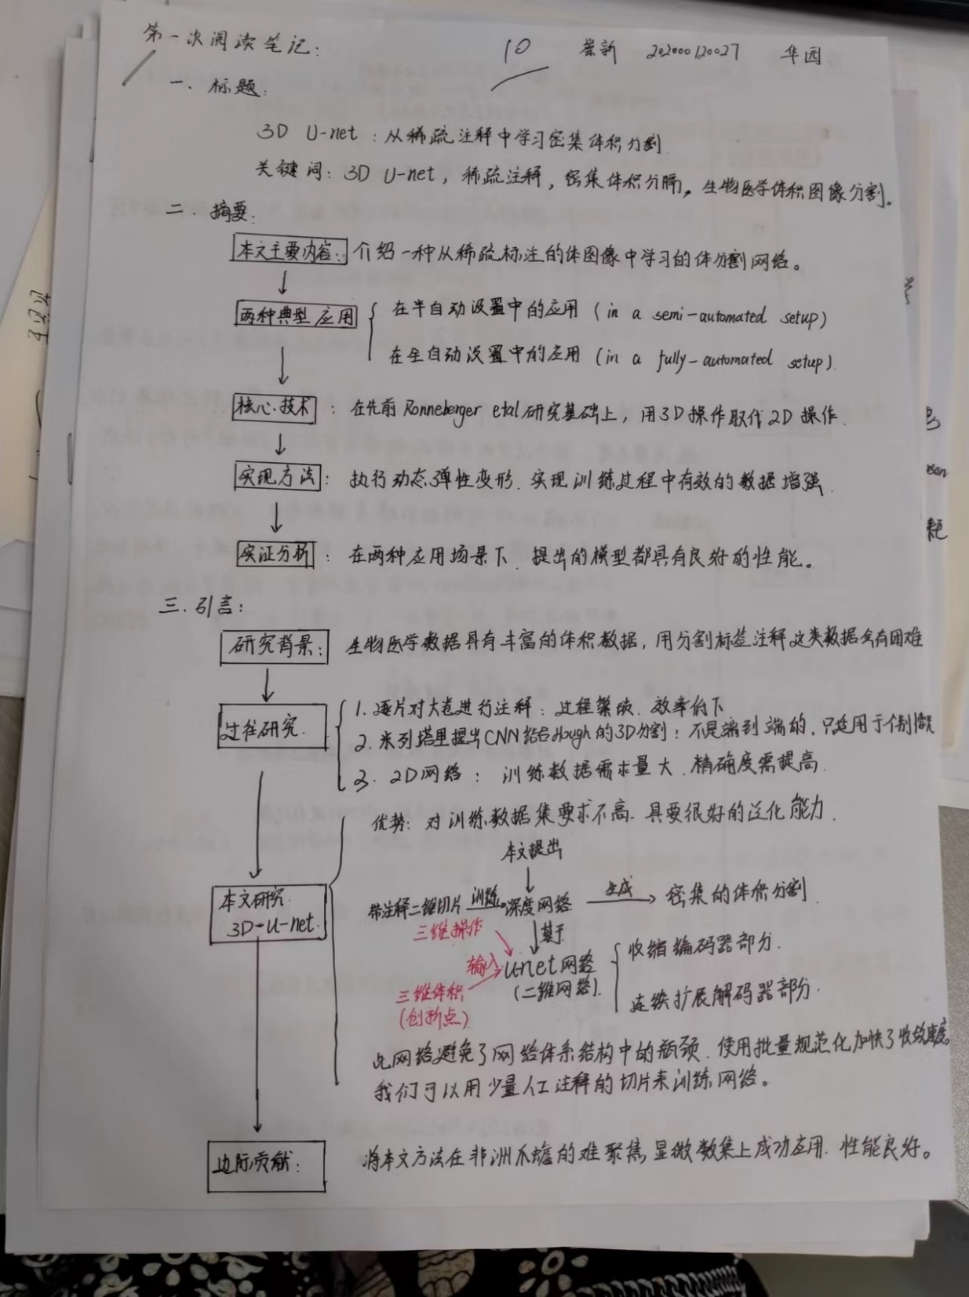

Slide 59
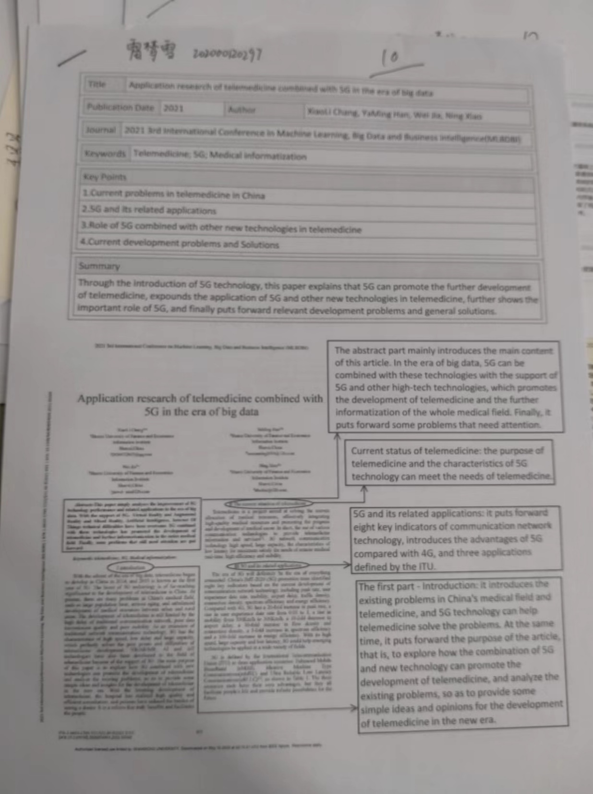

Slide 60
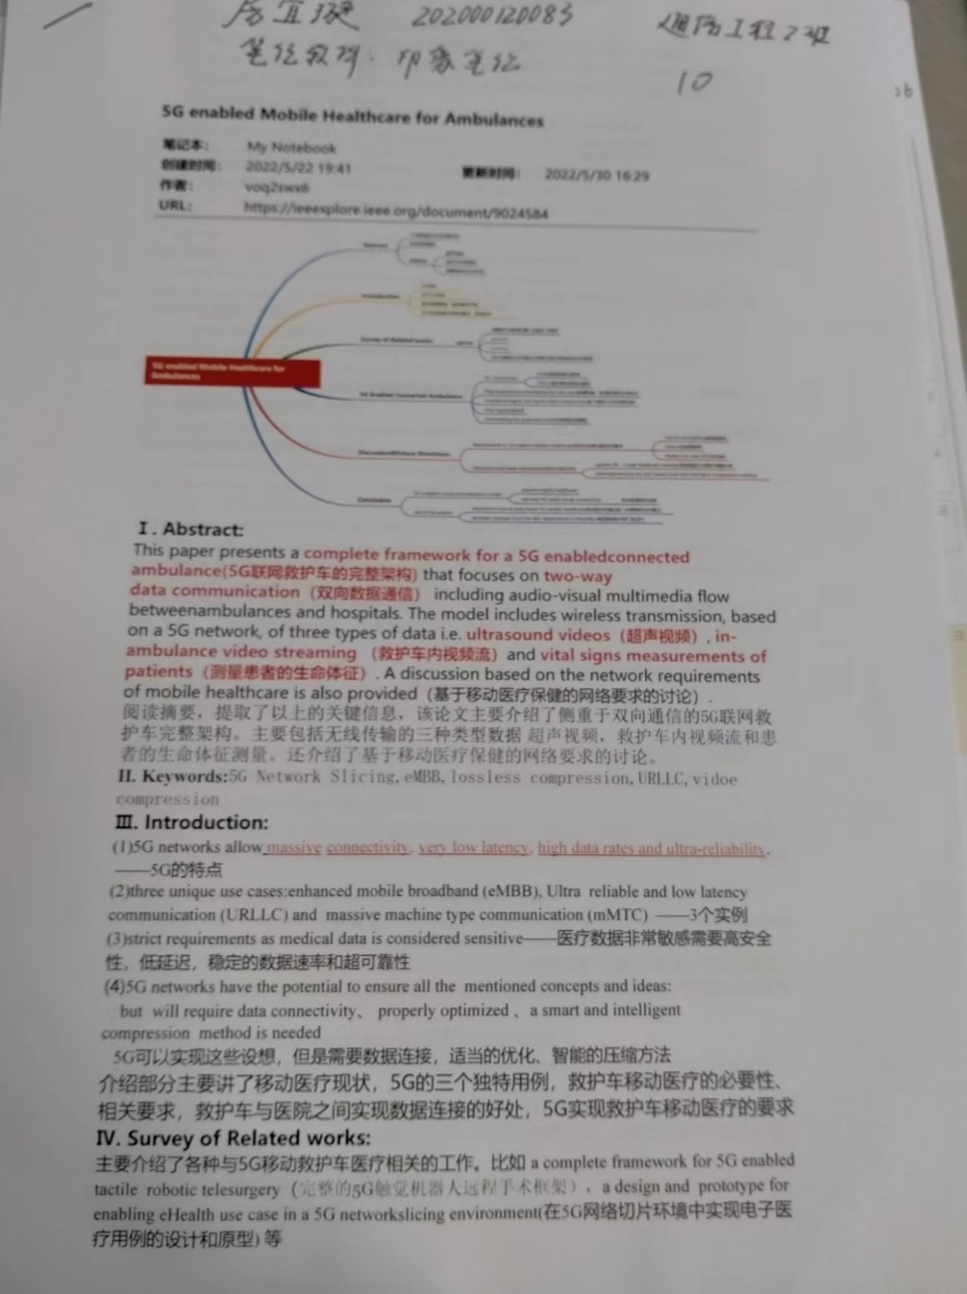

Slide 61
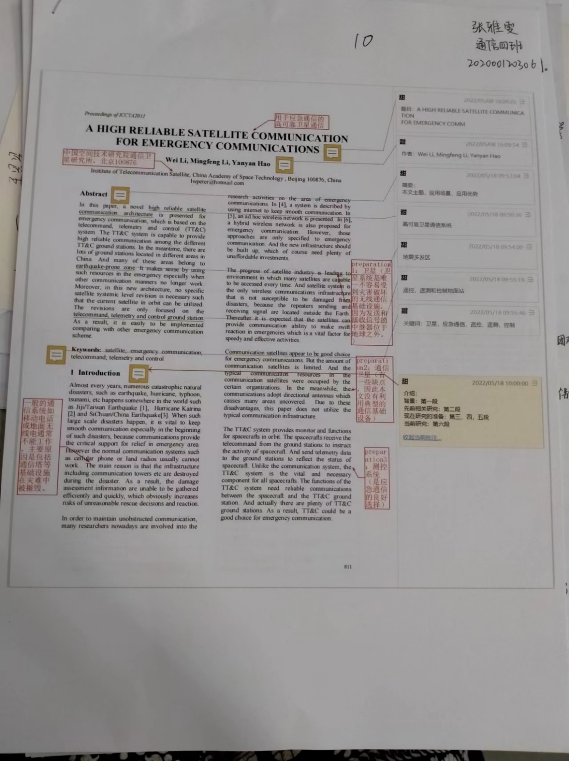

Slide 62
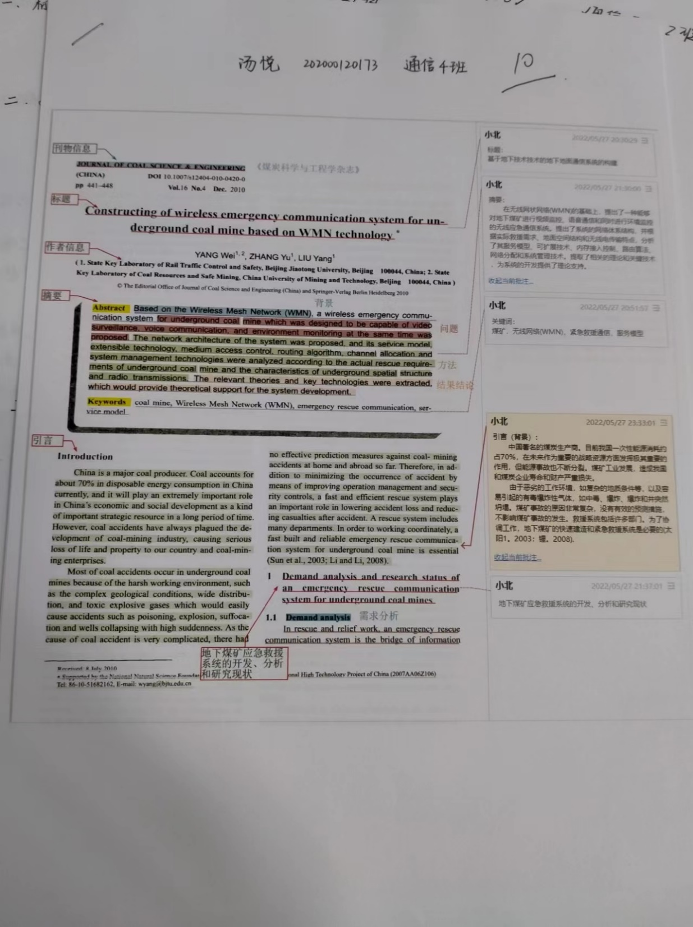

Slide 63


